Slide 1

Indoor Navigation System
Shengxiong Wu - 217993254
Haochen Wang - 216754236
EECS4080/EECS4090

Slide 2

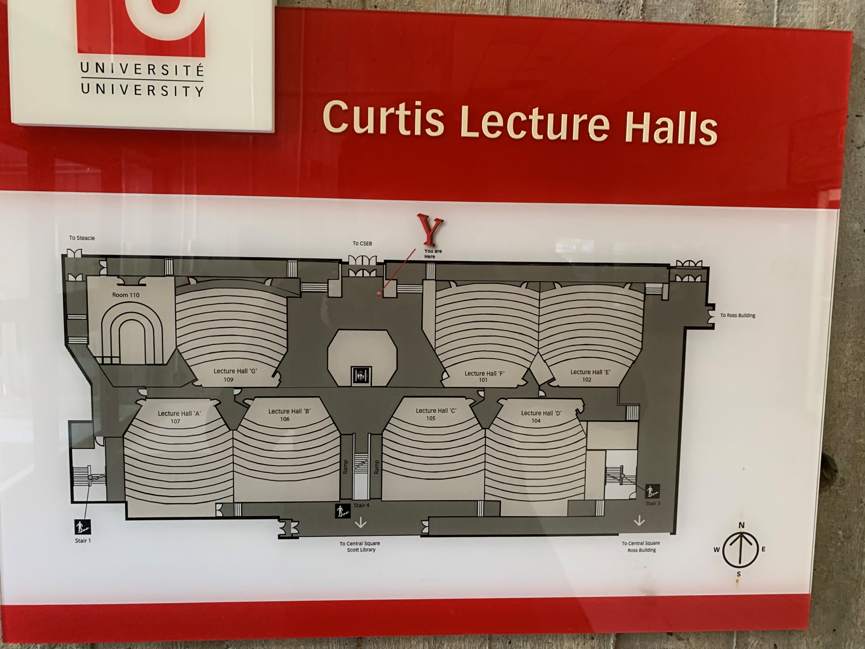
Introduction
Motivation
Freshman each year looking for classrooms
Only signage and map on the wall after entering a building

Slide 3
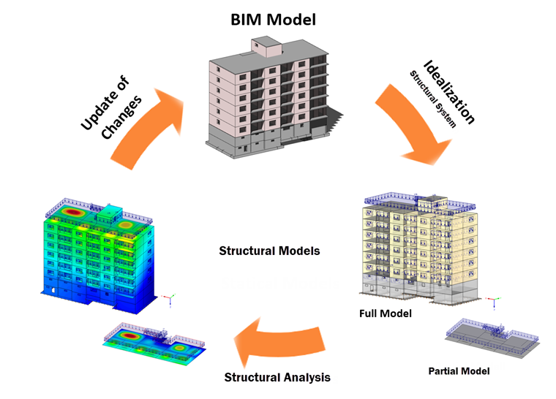
Introduction
Background
Google Map can not navigate inside the building
Common indoor navigation system (e.g. in the mall) required BIM
(Building Information Model)
Goal
Develop an indoor navigation system
Save time
Contribute to the York University Community
Web-based application that can navigate inside the building on campus

Slide 4
Software Development Life Cycle
Requirements Analysis
Design
Development
Testing
Deployment
Maintenance

Slide 5
Requirements Analysis
Functional Requirement:
Navigation Function
User Interface
Multi-floor support
Multi-building support
Non-Functional Requirement:
Response Time
Data Safety
Scalability
Technical Requirements:
Spring Boot
Web-development tech stack
Cloud deployment

Slide 6

Collection of the Floor Plan Data
Map diagrams on the wall
Research
Map Library

Slide 7

Floor Plan for CLH Level 2 by Photo

Slide 8
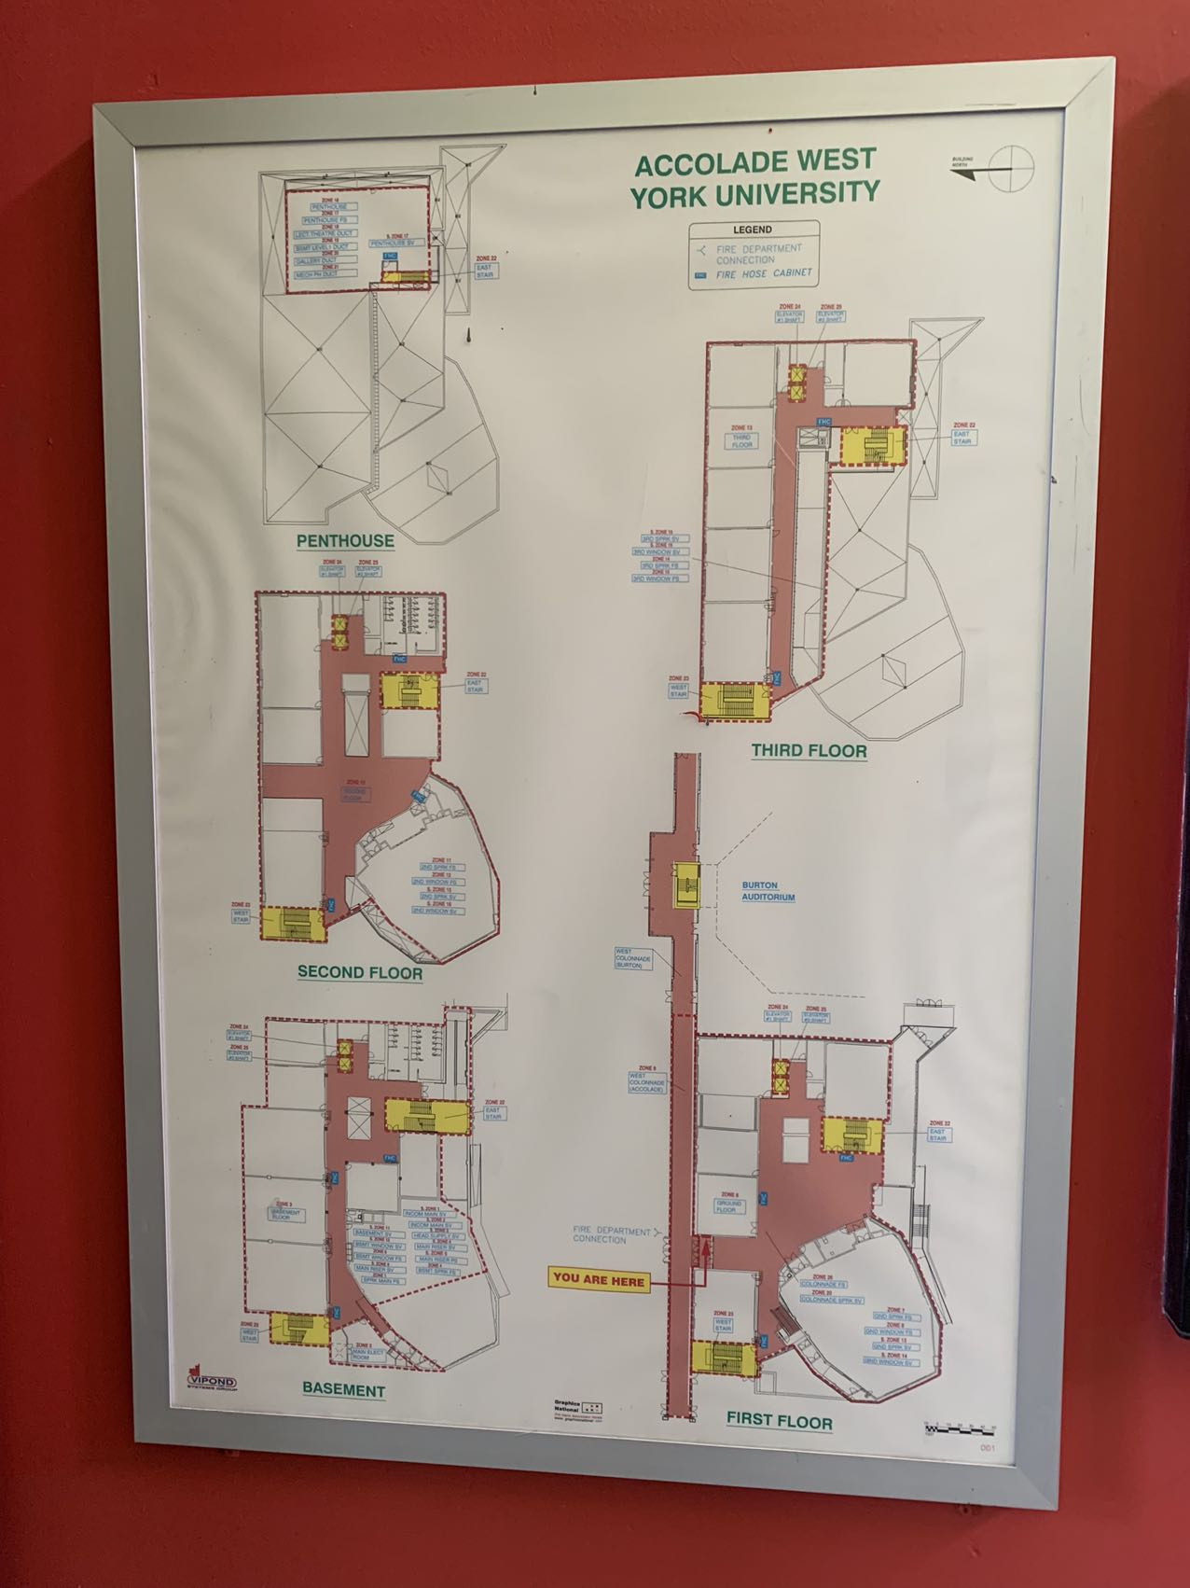
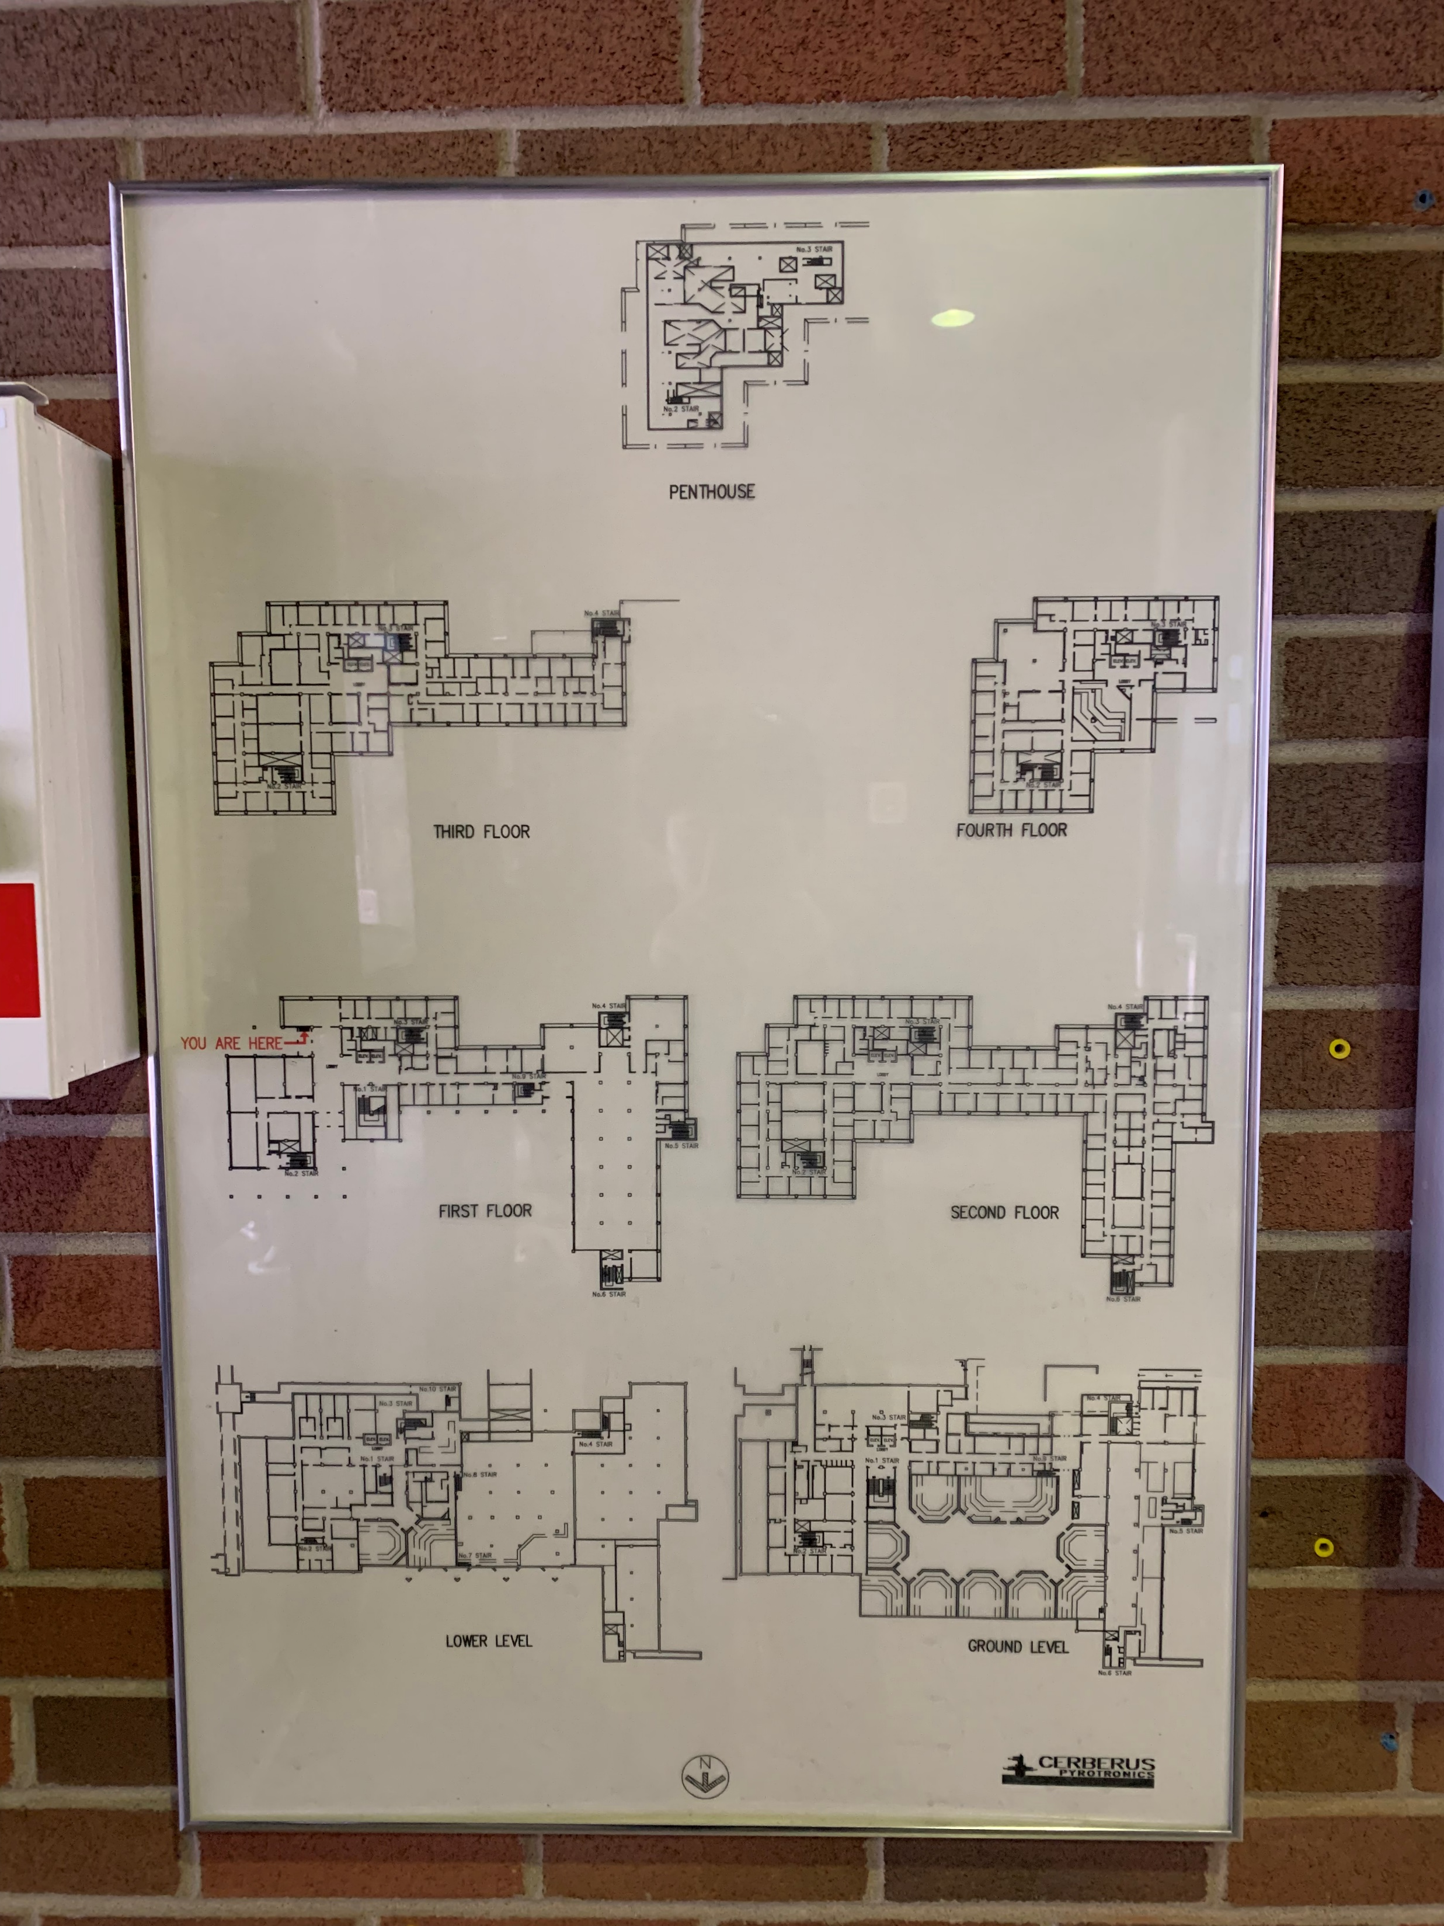
The format of floor plans varies across different buildings

Slide 9
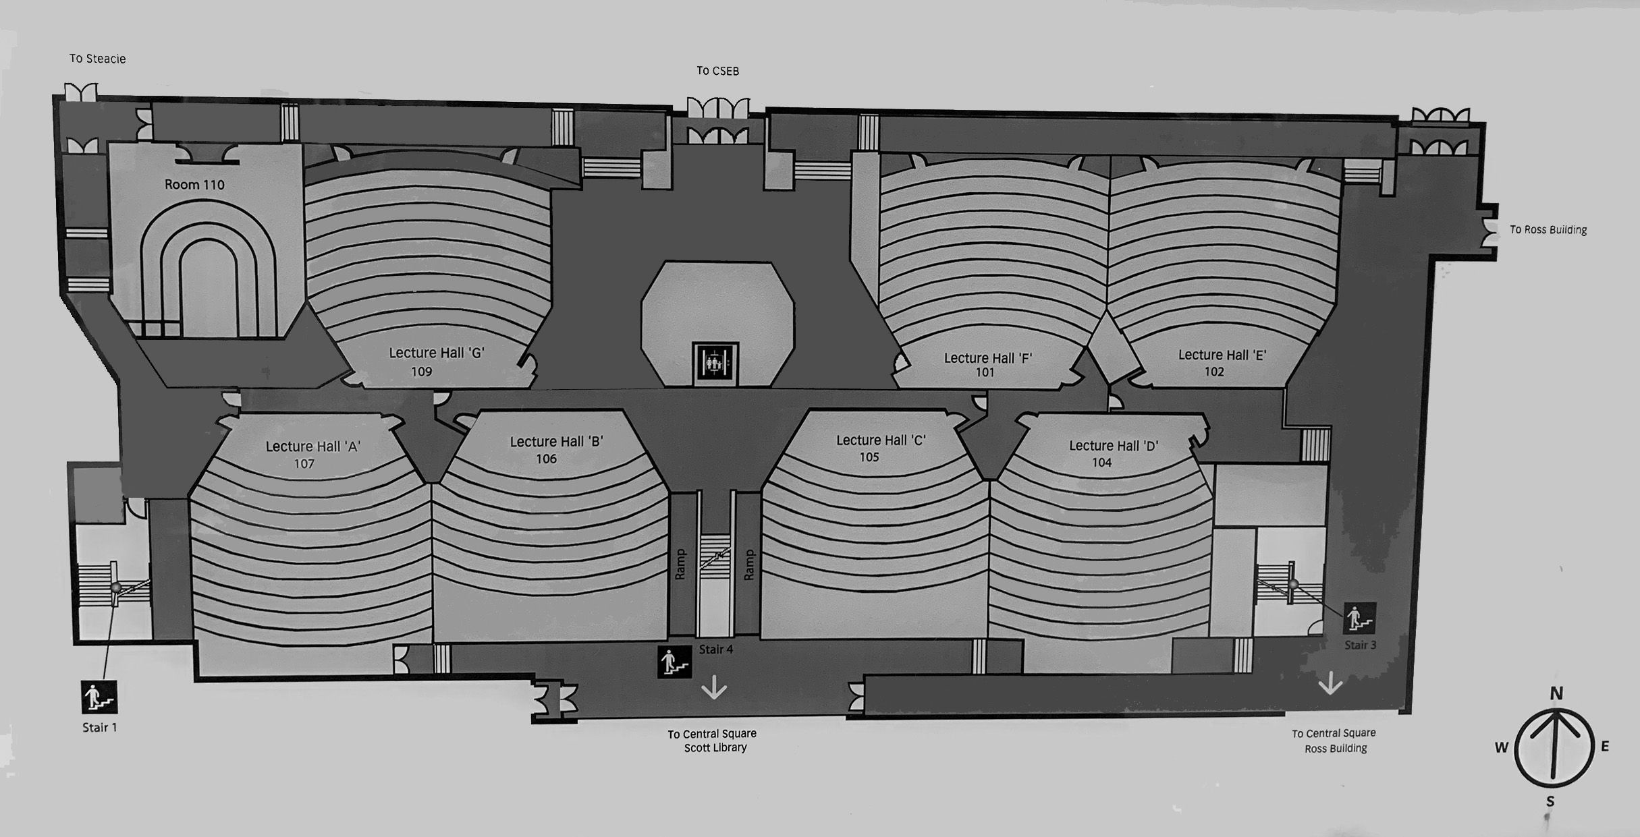
Preprocessing of the Floor Plan Image
Size
Position & Aspect
Color

Slide 10
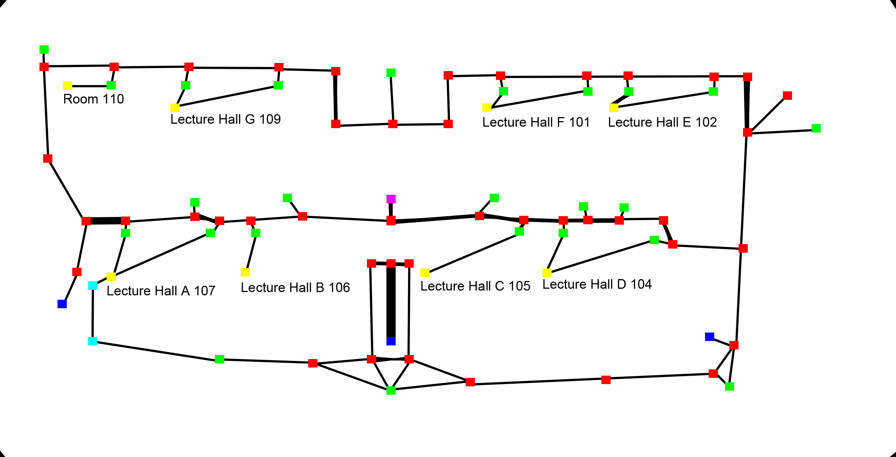
Extract and Encode Information from the Floor Plan
Encode as a graph
POIs (Point of Interest)
as vertices (nodes)
Pathways
as edges
Drawn as pixels onto the floor plan
POI type encoded with color
Notated image parsed by backend with CV (Computer Vision)
Graph serialized into database

Slide 11
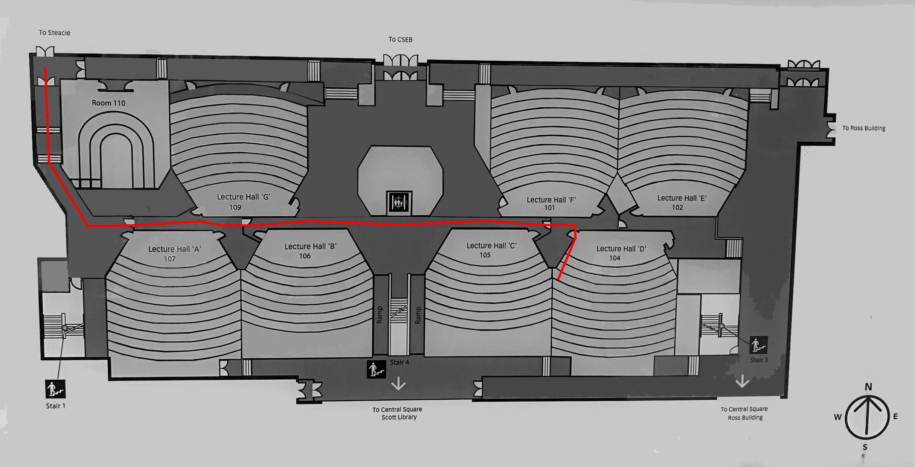
Automatic Pathfinding
Obtain the user input
the source and destination node
Single-source shortest path problem
Dijkstra's algorithm
Result is drawn onto the floor plan image as pixels
Return image to the frontend

Slide 12
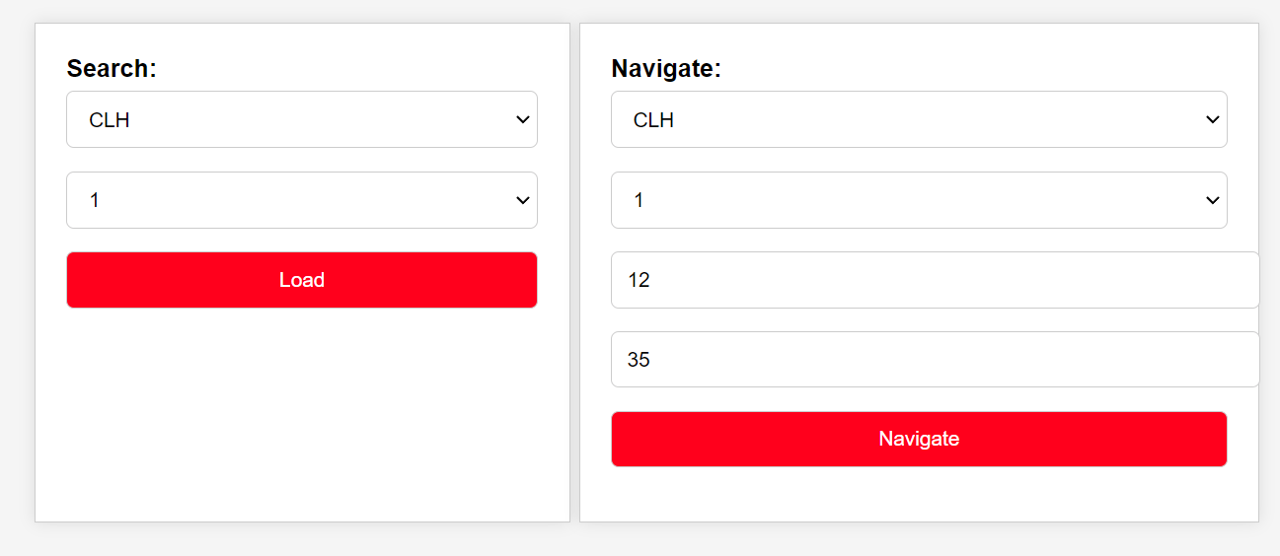
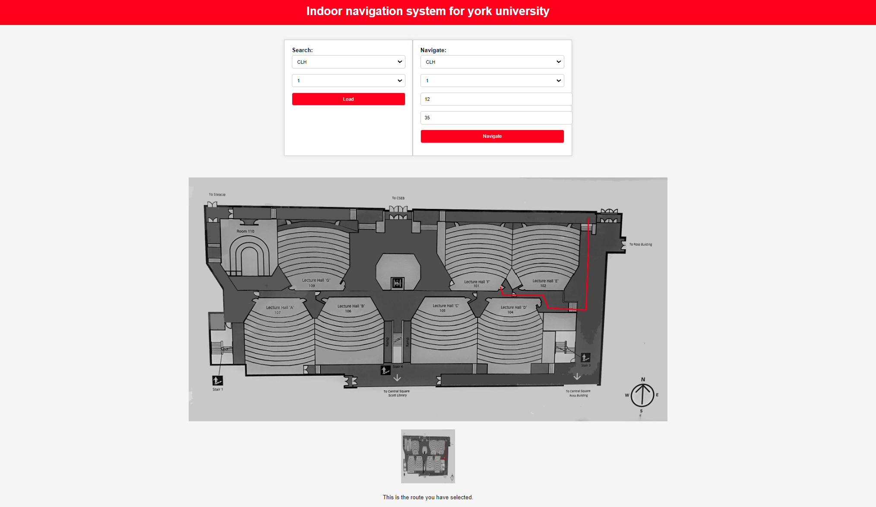
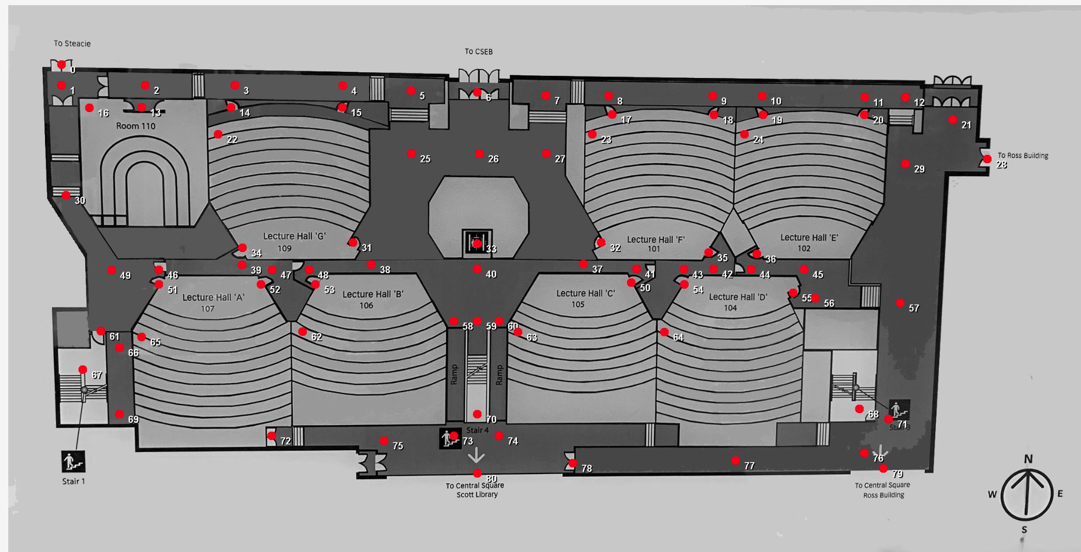
First Functional Prototype

Slide 13
Problems
Needs better quality floor plan images
Needs more efficient way to extract information
Needs to navigate by using room name rather than node index

Slide 14
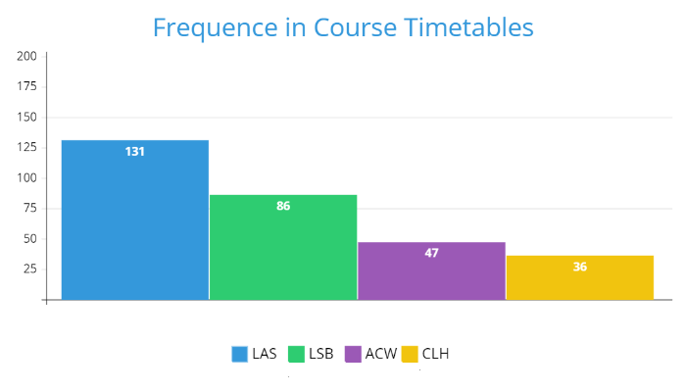
Help from Facilities Services/Campus Planning, Design & Construction
Request of CAD drawings fulfilled
Up to 5 buildings
By course classroom popularity
LAS (Lassonde Building)
LSB (Life Sciences Building)
ACW (Accolade Building West)
CLH (Curtis Lecture Halls)
R (Ross Building)

Slide 15
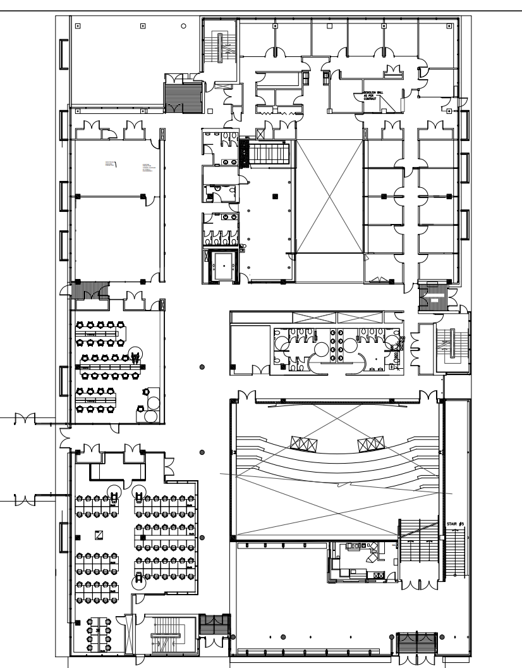
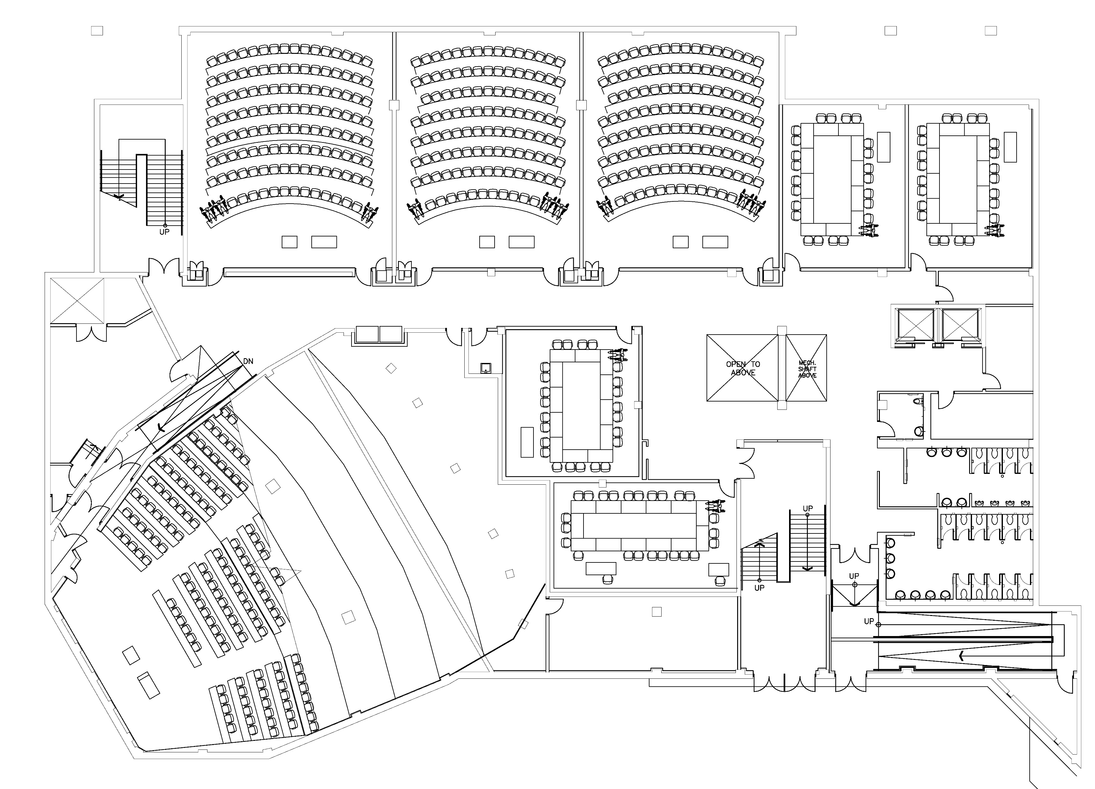
Digital Floor Plan

Slide 16
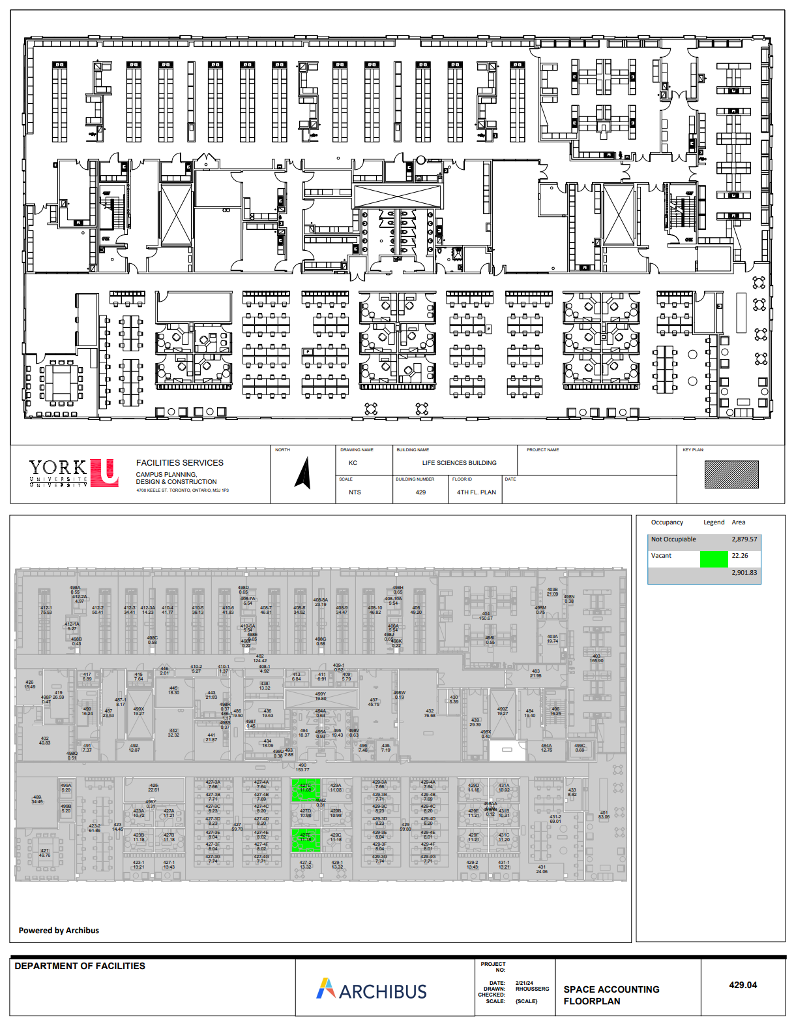
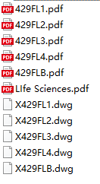
An Improved Notation Tool
Vector drawings delivered
Manual notating is still needed for now
Self-contained? Easy to use? Intuitive?

Slide 17

Notation Tool: Requirement Analysis
Needs to ready-to-use
Small footprint
Internet connection independent
Works locally with only the floor plan image
Save to local then deploy to backend
Should be as intuitive as possible
Similar mode as the last generation solution
Point-and-click interaction
Performance shall be acceptable
As many as several hundred nodes on a single floor
Web-based solution with HTML + CSS + JS
HTML5 Canvas
Render anything controlled by JS
Not very easy to use!

Slide 18
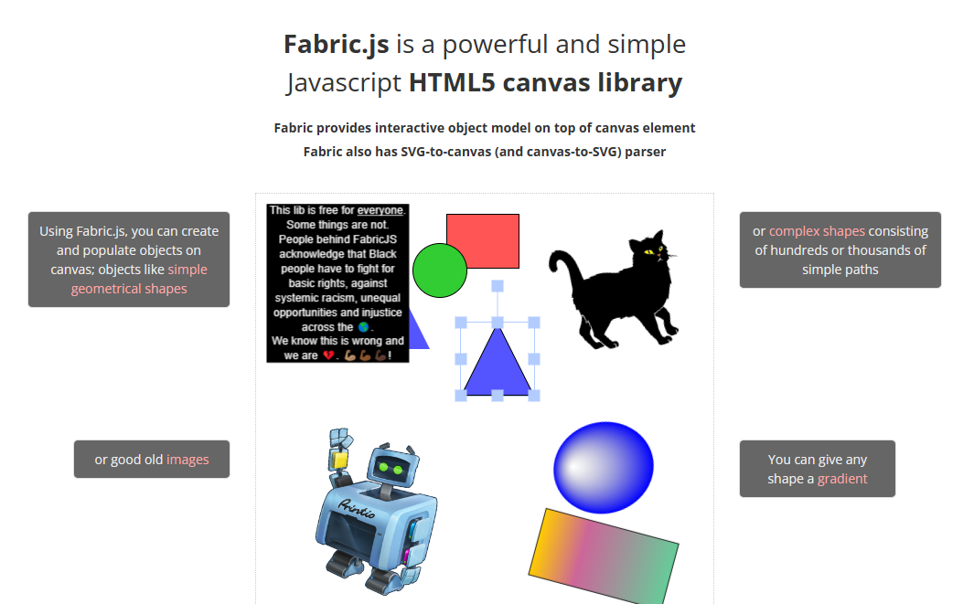
Enter Fabric.js

Slide 19
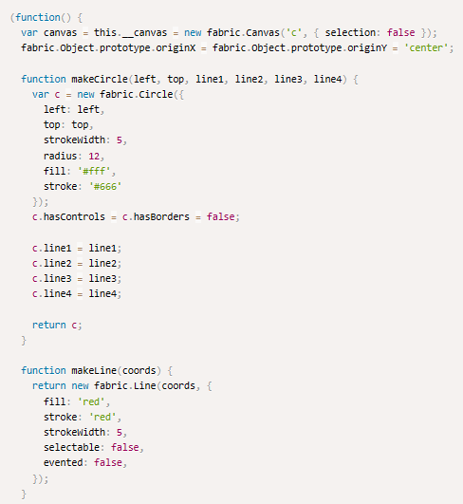
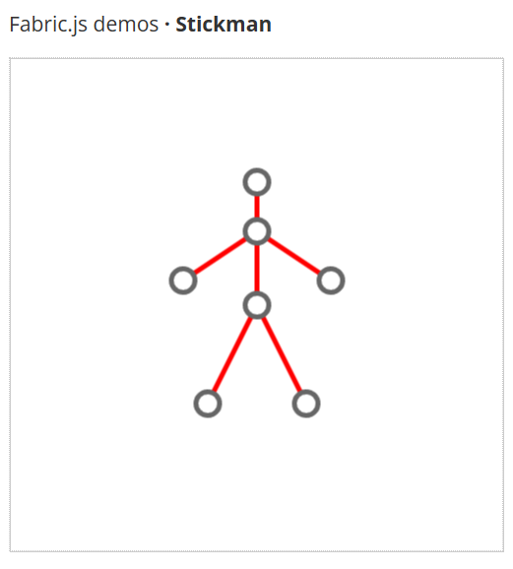
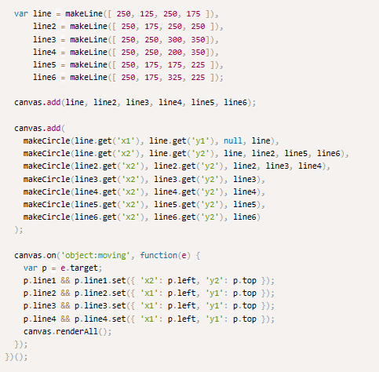
Looks familiar…

Slide 20
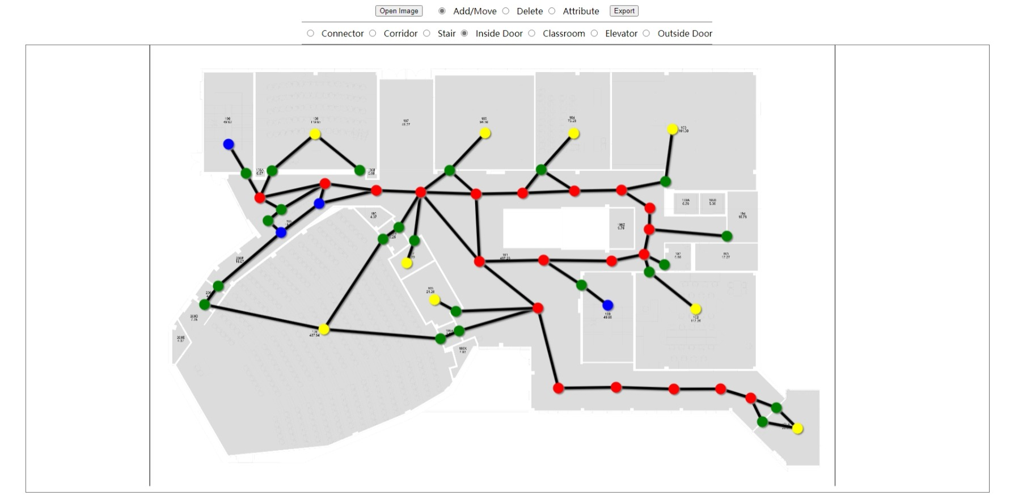
Notation Tool: Prototype

Slide 21
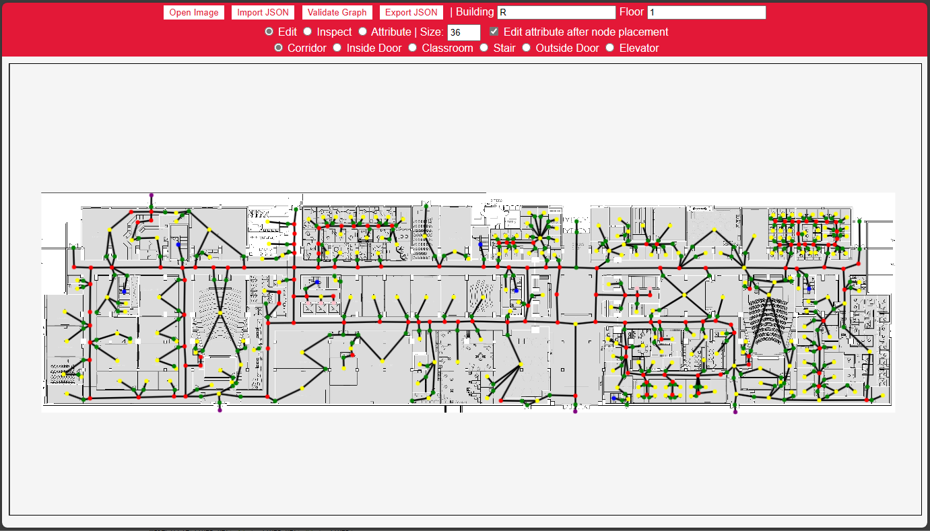
Notation Tool: Current State

Slide 22
Notation Tool: Efficiency
Tested with Ross Floor 1
Tested with CLH Floor 1
More than 40% faster

Slide 23
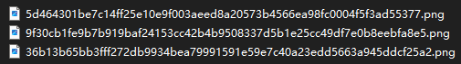
Result Caching
Generating the result images is SLOW!
~3 – 5 s for a single image
How to improve?
Key to the solution: the results are unique with each route selected
Reusing is possible!
On-server cache needed
Unique key, Put, Contains, TTL
Unique key source
Route information → [?] → Unique key
Hashing
Start: CLH Floor 1 - Lecture Hall A
End: LAS Floor 1 - 1005-WC
navigate
CLH1_LectureHallA -> Campus_CLH
Campus_CLH -> Campus_LAS
Campus_LAS -> LAS1_1005-WC
getResultFileName

Slide 24

Result Caching
Popular cache database: Redis
Fast
Easy to deploy and use
Comes with everything we need
Not optimized for large binary storage
In memory!
Local filesystem
Unique Key: Filename
Put, Contains
TTL: Last Modified w/ scheduled cronjob
Another reason
Will talk about that in a second

Slide 25

Cloud Deployment
It’s a web application
Several things needed to deploy
Virtual Private Server (VPS)
Domain
TLS Certificate
VPS
Amazon Web Service Lightsail
Domain
Registered personal domain
gradproj.haoc.wang
DNS provider: Aliyun
Certificate
Let’s Encrypt
Free renewable cert for 3 months
ACME, certbot

Slide 26
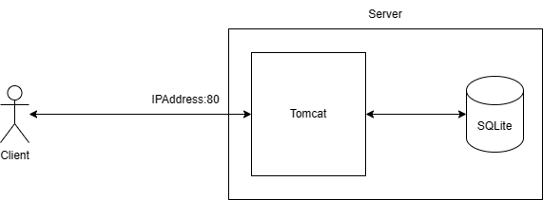
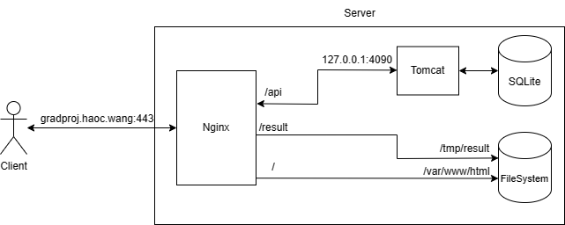
Cloud Deployment
Spring Boot’s built-in Tomcat is not very easy to configure
Compatibility with certbot
Performance
Reverse Proxy
Another web server in front of application web server
Nginx
Popular web server
Powerful proxy and rule configuration
Built-in support from certbot
Native-level local filesystem serving
Serve result cache from disk

Slide 27
Live Demonstration
https://gradproj.haoc.wang

Slide 28
Future Work
Improve the efficiency of the backend logics
Using Deep Learning or other CV techniques to automatically build the data from floor plan
Build the data in real time and location by using robot in the building

Slide 29

Thank You
Q&A and Defending Time
Shengxiong Wu – 217993254 – sxwu@my.yorku.ca
Haochen Wang – 216754236 – whc2001@my.yorku.ca

